Slide 1


Student Financial Aid for Year 2020-2021
Helping you plan, apply, and pay for college

Slide 2
Terms to Know
Financial Aid
Cost of Attendance (COA)
Expected Family Contribution (EFC)
Free Application for Federal Student Aid (FAFSA)
Financial Aid Administrators
Where to receive assistance

Slide 3
Financial Aid
The federal government and your state government provide assistance to help cover the costs of higher education
This is your tax dollars at work
Families are expected to contribute what they are able to pay
This is based on a formula that considers many family circumstances including income and assets

Slide 4
Scholarships
Four main resources:
  Local (work with school counselor / word of mouth)
  Statewide (CFNC.org)
  Institutional scholarships (visit their websites)
  National scholarships

Slide 5
Cost of Attendance (COA)
Tuition and fees
Room and board
Books and supplies
Transportation
Miscellaneous personal expenses

Slide 6
Expected Family Contribution (EFC)
Measurement of student’s and family’s ability to pay postsecondary educational expenses
  Student’s contribution
  Parent contribution (for dependent students)
Determined by a formula that considers students and parent income and assets

Slide 7
What is Financial Need?
Cost of attendance (COA) – Expected family contribution (EFC) = Financial need

Slide 8
Categories of Financial Aid
Need-based aid
Merit-based aid

Slide 9
Types of Financial Aid
Scholarships
Grants
Work-Study Employment
Loans
Self-Help Aid
Gift Aid

Slide 10
Sources of Financial Aid
Federal Government
Employers
State Aid
Private Sources
College and Universities

Slide 11
NC State Grants
Must Complete the FAFSA
NC Education Lottery Scholarship (ELS)
  NC community colleges/UNC institutions
NC Community College Grant (CCG)
  NC community colleges
UNC Need-based Grant (UNCNBG)
  UNC institutions
NC Need-based Scholarship (NBS)
  Eligible NC Private Institutions

Slide 12
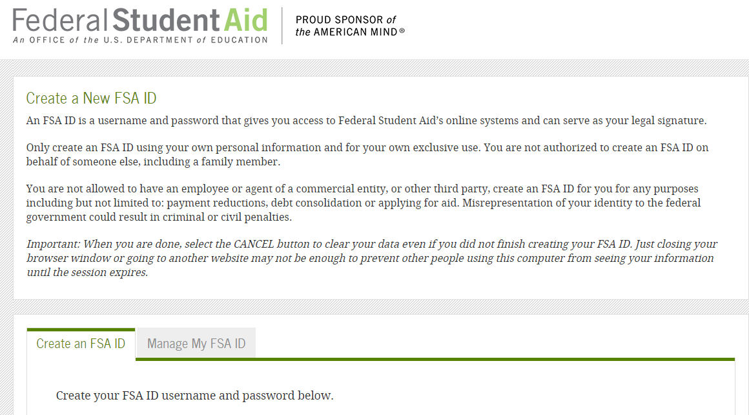
Apply for Your FSA ID Before Completing the FAFSA
Students and at least one parent whose information will be listed on the FAFSA need to sign electronic documents using the FSA ID
It’s not required, but things go much more smoothly when you apply for your FSA ID before sitting down to do the FAFSA
FSAID.ed.gov

Slide 13
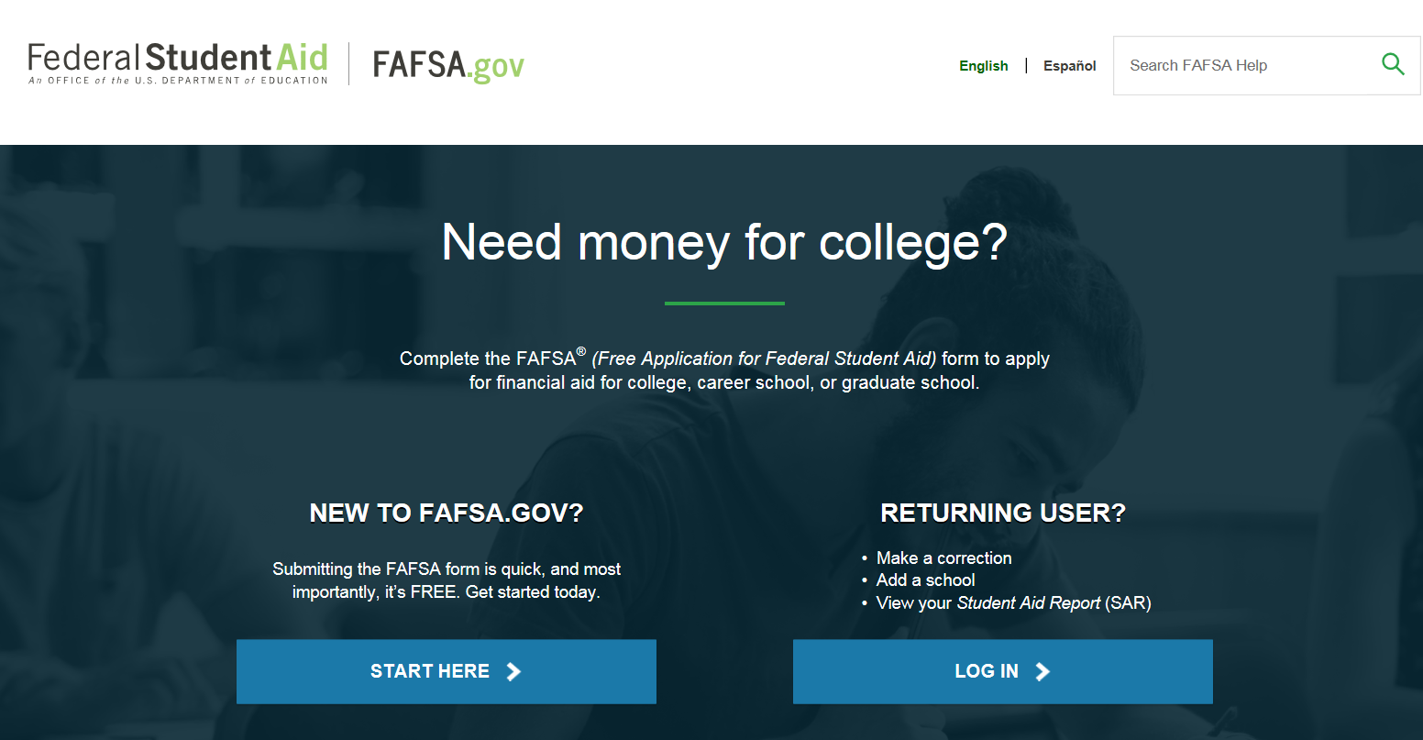
Free Application for Federal Student Aid
(FAFSA)
Free Application for Federal Student Aid (FAFSA)
  fafsa.gov
Signature FSA ID
  FSAID.ed.gov

Slide 14
Free Application for Federal Student Aid
(FAFSA®)
Collects demographic and financial information
Information used to calculate the expected family contribution (EFC)
Colleges use EFC to award financial aid
Available in English and Spanish

Slide 15
Free Application for Federal Student Aid
(FAFSA®)
May be filed at any time during an academic year, but no earlier than October 1st prior to the academic year for which the student requests aid
For the 2020-21 academic year, the FAFSA may be filed beginning October 1, 2019
Use 2018 tax information
Colleges may set FAFSA priority dates

Slide 16





Free Application for Federal Student Aid
(FAFSA®)
FAFSA on the Web (FOTW)
myStudentAid mobile app
Paper or PDF FAFSA
FAA Access to CPS Online
FAFSA on the Phone (FOTP)

Slide 17
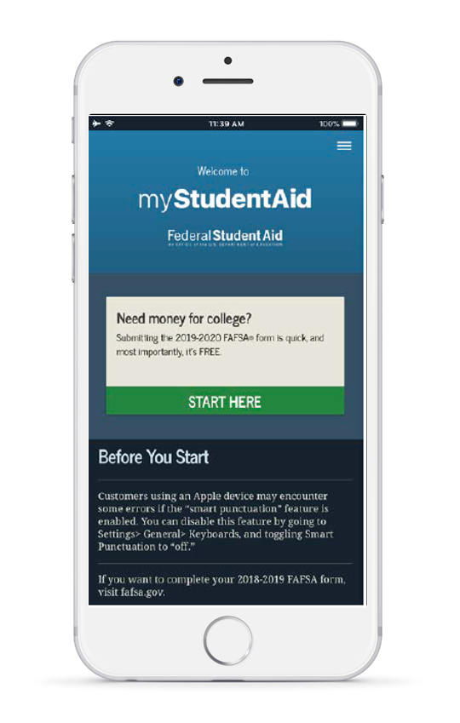

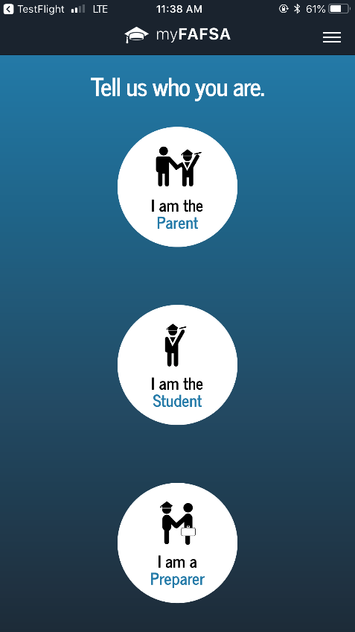
myStudentAid Mobile App
Mobile ability to begin, complete, save, and submit the FAFSA

Slide 18
IRS Data Retrieval Tool (DRT)
Allows for certain tax return information to be transferred from the IRS database
Participation is voluntary and student chooses whether or not to transfer data to FOTW
IRS will authenticate taxpayer’s identity
If tax record is found, IRS transfers information to populate the FAFSA
Reduces documents requested by financial aid office, if used (recommended, if eligible to use)

Slide 19
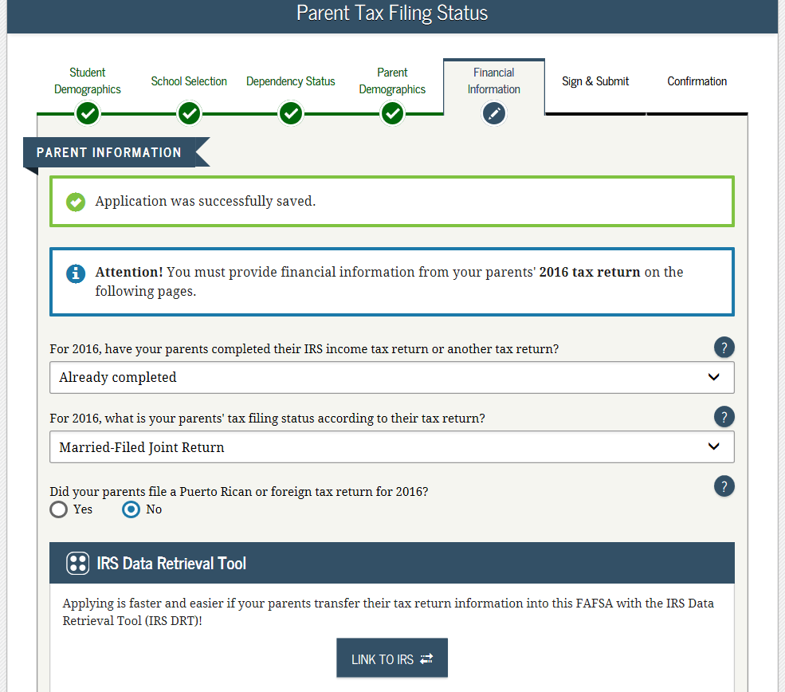
Financial Information
IRS Data Retrieval Tool
Transferring
information directly
from the IRS if
eligible is the fastest
and easiest way to
complete the tax
information
Will need FSA IDs

Slide 20
IRS Data Retrieval Tool
Certain tax filers cannot use the
IRS Data Retrieval Tool
Did not indicate on FAFSA a tax return was completed
Marriage date is January 2019, or later
First three digits of the SSN are 666
Filed a non-U.S. tax return
Married and filed as head of household, or filed separate returns
Neither married parent entered a valid SSN
Non-married parent or both married parents entered all zeroes for the SSN

Slide 21
I’m a Citizen, but My Parents . . .
Students who are citizens or eligible noncitizens can still receive federal and state financial aid
Parents who are not citizens should
  Include their income and assets on the FAFSA
  Use nine zeros as their Social Security numbers

Slide 22
General Student Information Provided on the FAFSA
Social Security Number
Citizenship status
Marital status
Drug conviction of possession or sale
Selective Service registration
Highest education level completed by father/mother

Slide 23
Information About Parents of
Dependent Students
Tax, income, and other financial information
Dislocated worker status
Receipt of means-tested federal benefits in the previous two years
Assets
Untaxed income

Slide 24



Who Are the Parents?
Biological or adoptive parents married to each other – student lives with both parents
Biological or adoptive parents who are not married to each other and are living together
A single parent who is widowed or never married
Separated/Divorced parents not living together – list the parent with whom the student lived most often – include stepparent information if the parent has remarried
Always include stepparent if a parent has remarried
Notes:
New Definition of Parents - Beginning with the 2014-2015 FAFSA, dependent students will be required to include on the FAFSA income and other information from the dependent student’s legal parents (biological or adoptive) regardless of the parents’ marital status or gender, if those parents live together.
•Biological Parents or Same Sex Parents (regardless of state authority related to marriage) should use this response if appropriate
•Smart Logic will modify follow-up questions with gender-neutral identifiers: Parent 1 and Parent 2 instead of mother and father
Following the U.S. Supreme Court decision on June 26, 2013 overturning the Federal Defense of Marriage Act, the Department of Education is reviewing the recent Supreme Court decision on DOMA and its impact on the federal student aid programs. They will provide information and guidance on this matter as soon as it is available.

Slide 25
Signatures
Required
  Student
  One parent (dependent students)
Format for submitting signatures
  Electronic using FSA ID
  Signature page
  Paper FAFSA

Slide 26
Frequent FAFSA Errors
Social Security Numbers
Divorced/widowed/remarried parental information
Income earned by parent/stepparent
Untaxed income
U.S. income taxes paid
Household size
Number of household members in college
Real estate and investment net worth

Slide 27
After FAFSA Submission
Student receives a confirmation email
Student receives a Student Aid Report (SAR)
  Check carefully for EFC, any errors and how to correct
Verification
  There may be a need for additional information
  DON’T PANIC!
  Simply provide the information requested

Slide 28
Making Corrections
If necessary, corrections to FAFSA data may be made by:
Using FAFSA on the Web, if student has a FSA ID;
Updating paper SAR; or
Submitting documentation to college’s financial aid office.

Slide 29
Special Circumstances
Conditions exist that cannot be documented with the FAFSA
Send written explanation and documentation to your college’s financial aid office
College will review and request additional information if necessary
Decisions are final and cannot be appealed to U.S. Department of Education

Slide 30

Special Circumstances
Other unusual issues
Unusual uncovered medical/dental expenses
Extraordinary dependent care
Student cannot obtain parental information
Parent or spouse death
Loss of employment
Divorce

Slide 31
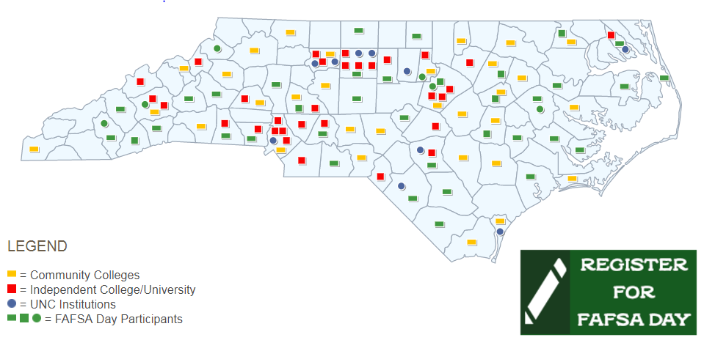
2019 FAFSA Day
Saturday, October 26, 2019
9:00 a.m. to 12:00 p.m. at most locations
Register at CFNC.org or call 866-866-CFNC
Notes:
FAFSA Day sites in all 100 counties
Some are hosted by colleges/universities
Some are hosted by SECU branches
Come prepared with any 2013 tax return information
Bring the student and parent Federal Student Aid PIN
31

Slide 32

Residency Determination service (RDS)

Slide 33
Overview
A uniform process for determining NC residency used for in-state tuition and NC grant eligibility.
There are three ways a student can access RDS:
  Directly on the RDS website at www.ncresidency.org
  Through the CFNC admissions application
  Through 3rd party admissions applications the UNC campuses may use – a link to RDS is included on the admissions application
Use your CFNC.org user name and password to log in
Notes:
Students must be a legal citizen to be considered for residency. US Citizen students with non-documented parents do have the ability to prove residency, receive in-state tuition, and state grants. Undocumented students do not have the ability to receive state grants. VIP – if student happens to be homeless, RDS will work with the student to identify how to document/prove residency.
RDS is designed to determine residency for tuition purposes in a coordinated and similar manner

Slide 34
Residency Determination Service (RDS)
Residency is usually based on parents’ domicile and not the student’s. Students should be prepared to provide information such as parent and student social security numbers (or other identifiable number), residence information, tax return information, vehicle registration, driver’s license and other residentiary specific information.

Slide 35
Residency Determination Service (RDS)
Reconsideration and Appeal
  Reconsideration
    May request at any time and up to 3 within 90 days
    Complete reconsideration if initially provided incomplete or inaccurate information, failed to submit documentation, or had a change in living situation
  Appeal process
    Only have 10 days to submit a notification of appeal from the date of your determination
    Have an additional 25 days to complete process after the notification to appeal
    Two types of appeal
      RDS Appeal – first level appeal
      SEAA Appeal – final state-wide level appeal

Slide 36
RDS Resources
  Side-by-Side FAFSA and RDS Completion Tool
  Appeal Process Fact Sheet
  Appeal Process Fact Sheet Spanish
  ncresidency.org – FAQ
  The documents above, and many more, can be found at: https://www.cfnc.org/rdsresources
  RDS Call Center Toll-free 844-319-3640
    Email: rdsinfo@ncresidency.org

Slide 37

Evaluating Your Financial Aid Offer Letter
Amount of gift aid offered?
Requirements for scholarships?
  Is the scholarship renewable?
Requirements for institutional grants?
  Is the grant renewable?
How much remains to be paid after gift aid?
What is the process for obtaining a Federal Work Study position?
What amounts and types of student and parent loans are recommended?
Notes:
When evaluating a financial aid offer, consider total cost of attendance minus gift aid offered. The remainder has to be covered by the student and family. How will it be covered? Parent and student savings? Current income? Student borrowing? Parent borrowing? Other family members (grandparents, for example)?
What does the student have to do to get the same scholarship support in the future?
Sometimes institutional grants have renewal requirements – ask.
Can a Federal Work Study job help defray personal expenses?
If the student doesn’t qualify for Federal Work Study, are there other employment opportunities on campus?
Is the amount of loan to be borrowed manageable for EACH year?

Slide 38
Information You Might Find on Your
Financial Aid Offer Letter
Estimated Cost of Attendance
Disclaimers about the aid offered
A reminder to report the receipt of other financial aid you expect to receive
List of action/steps you must take to complete the process
Terms and conditions that apply to your financial aid offer

Slide 39

Questions?

